Slide 1
Automated Wireless Master Slave Path Following Robot System
Code name: Tom and Jerry

Slide 2
Team Members:
V Shaashwath
Sumanth S
Srivatsa M N
Suchith B S

Slide 3
Problem Statement(s)
Agricultural fields ( usage of multiple vehicles simultaneously).
Mining - Transportation of Raw material through fields .
Warehouses and Factories .
Shopping Malls.
All these arenas have one thing in common , they require repetitive tasks and the tasks have to be carried out with extreme precision and diligence . In fields such as Coal fields and mining sites accidents due to human error leads to loss of human life and expenses. Avoiding Multiple humans to do a job which can be done by one individual.

Slide 4
Project Ideology
To create autonomy between robots through intelligent communication techniques and coordination.
Create individual bots amidst which one of the bots serves as the Master bot and the other bot(s) serve as the Slave bot(s).
The master bot can either be controlled manually by a user or its working can be predefined and the slave bots follow or mimic the master bot with the same accuracy and robustness as the latter.
Minimize human intervention and improve work efficiency.

Slide 5
Working-Prototype
Communication : RF and DTMF
Drivetrain: Low RPM and high Torque motors driven by the motor drivers
Control Systems : 6 Axis Gyroscope PID controller.
Collision Systems: Ultrasonic Sensors
Controller Unit : Microcontroller -Arduino Mega .

Slide 6
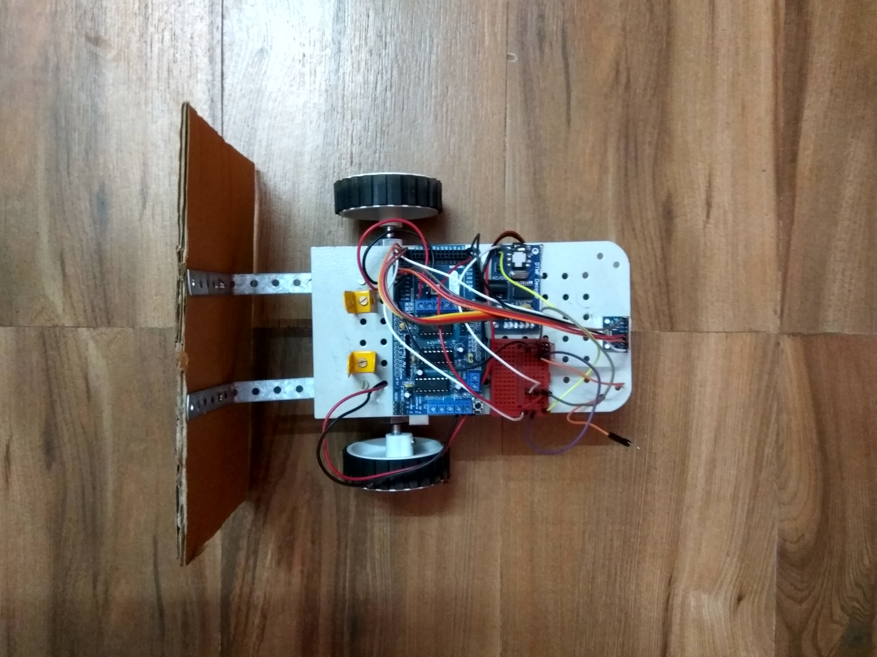
Constructed Master Bot

Slide 7
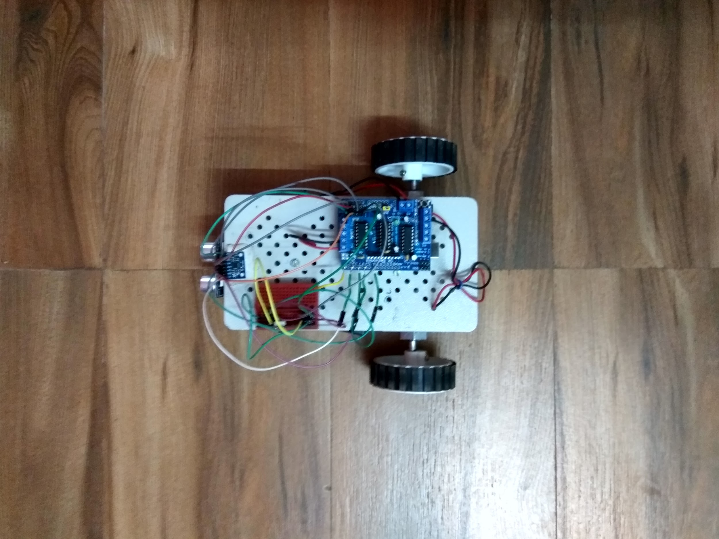
Constructed Slave Bot

Slide 8
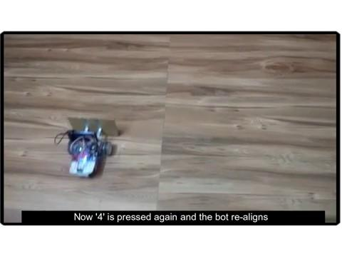

Slide 9
Working-Generalized
Can be customized according to the environment.
Once the Master bot/Target is in action the slave bots are initiated to follow the master in a intelligent manner using collision preventive methods.
Both the bots have precision guided PID systems for accuracy in paths and Machine Learning algorithms for improved efficiency
Visual Processing units can be incorporated.

Slide 10
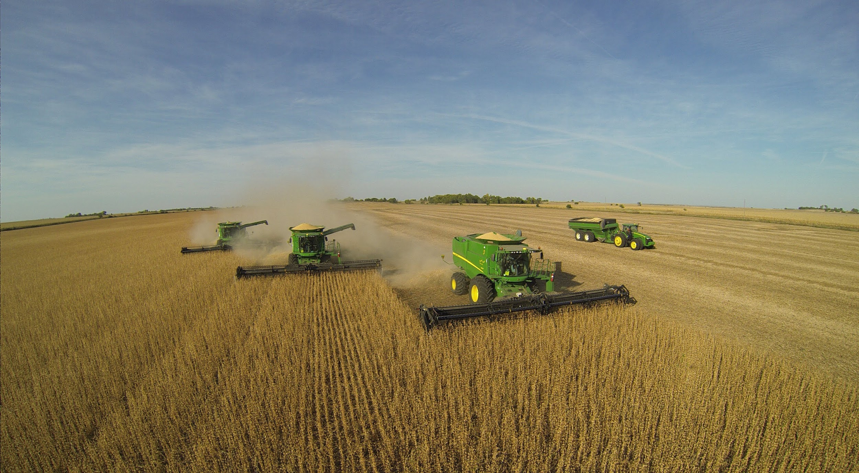
Real World Applications
Agricultural Fields - Harvesters can work in Master Slave Architecture .

Slide 11
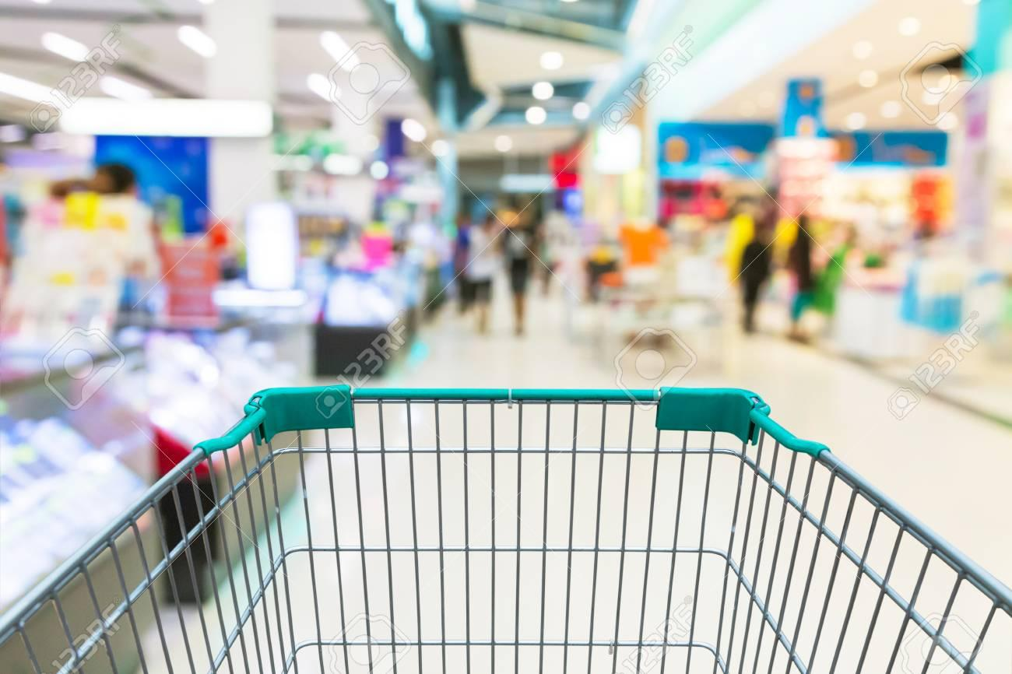
2. Shopping Malls- Smart Following trolleys

Slide 12
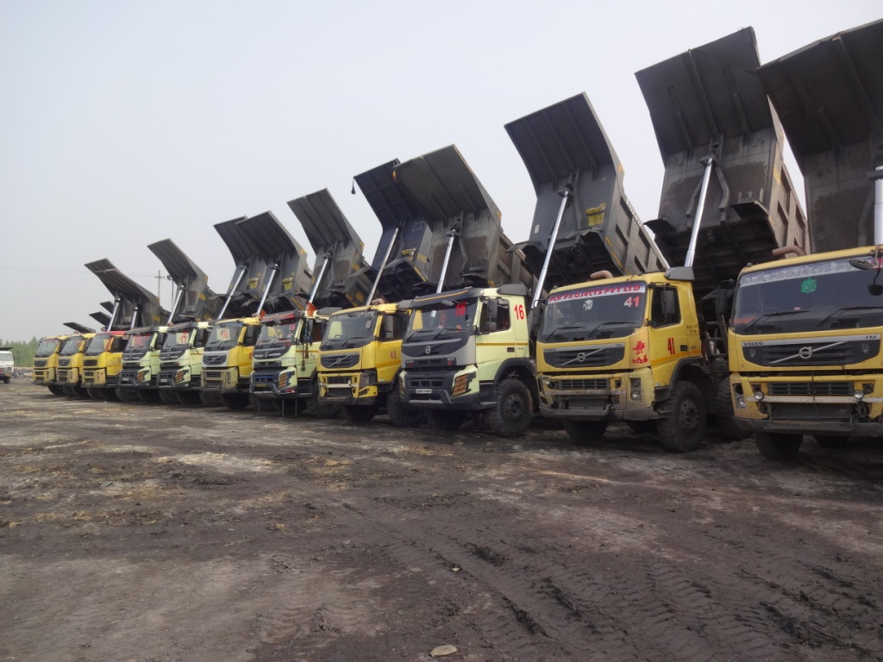
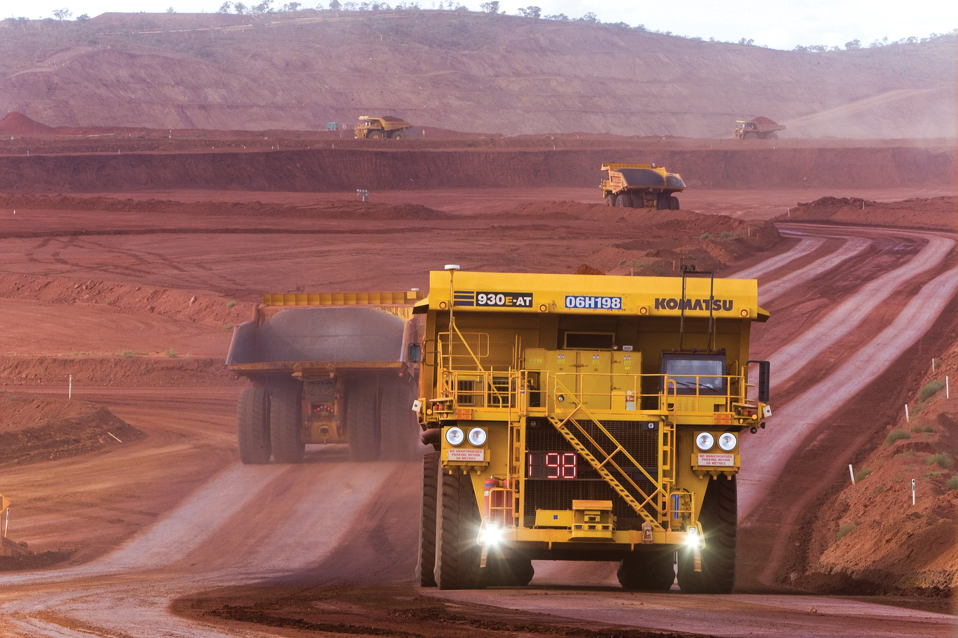
3. Mining Fields - Automation of multiple vehicles .

Slide 13
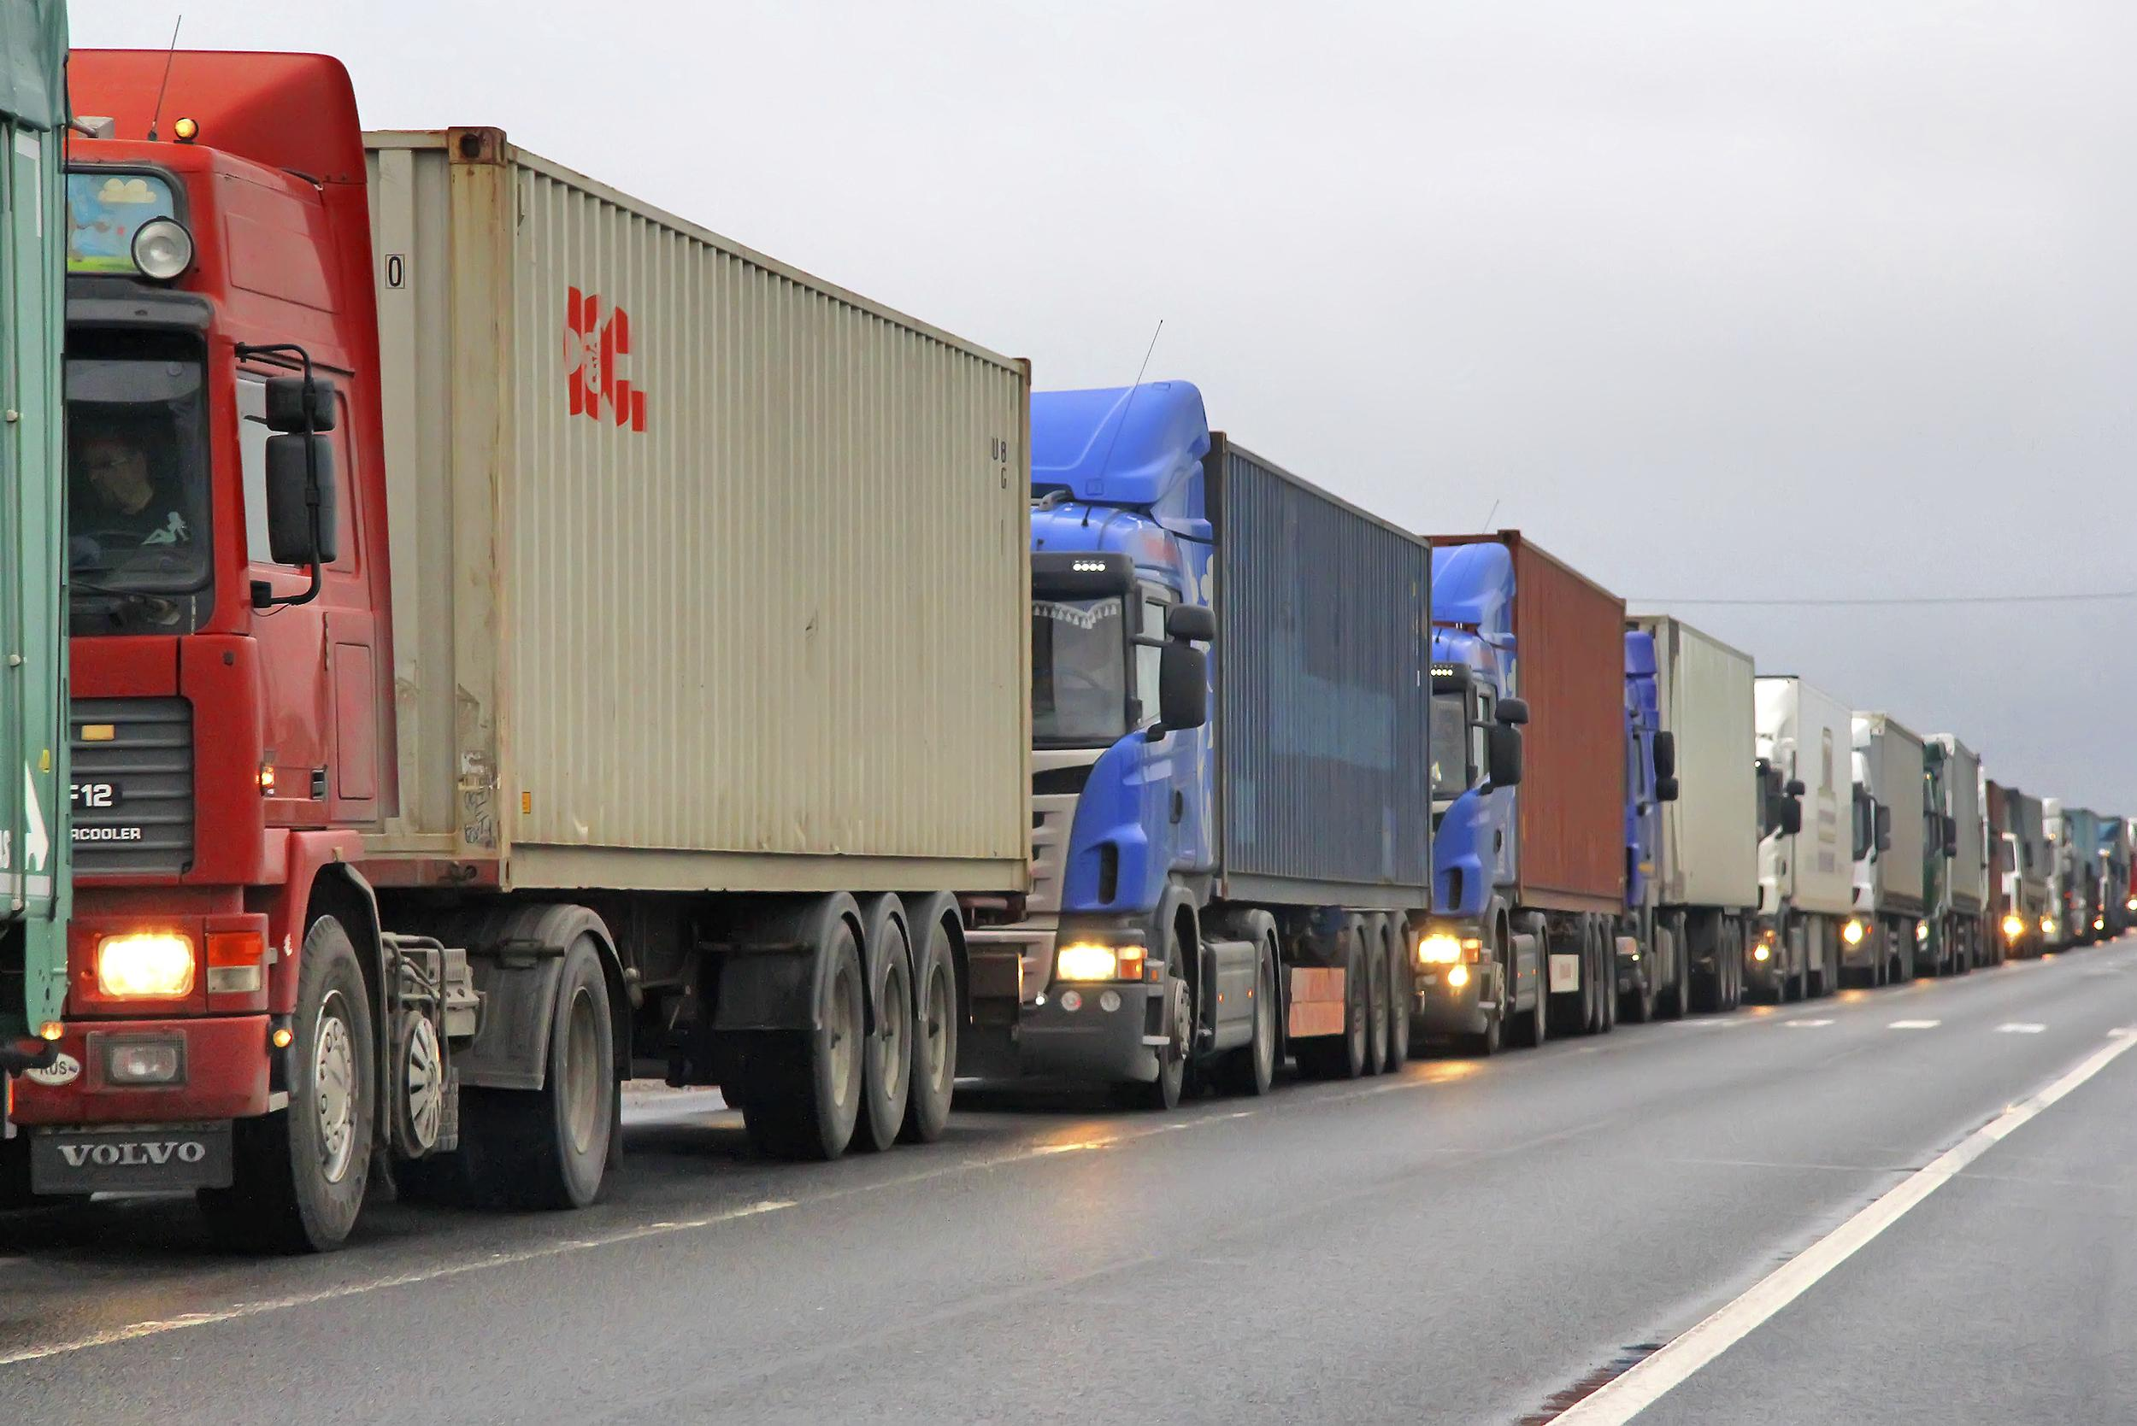
4. Warehouses and factories

Slide 14
Upgradation
Image Processing
Machine learning
Fabrication
Scaling

Slide 15
Requirements and Funding
High performance Processors .
High Performance Sensors and actuators.
Fabrication requirements for better quality materials.
Scaling - Testing and building scaled prototypes .
Visual processing aid , cameras , optical-sensors.

Slide 16
Conclusion
Rather than being a specific product , serves as a platform for serving a plethora of fields in all the walks of life.
Hence the usability, social value, technological advancement, possible potential to save human Life !
These factors contribute towards the urge to fulfill this project’s goal and reach the zenith.

Slide 17
Thank You

